Slide 1
Day 19
Linux Device Driver Training
Signal Handling
Presented by,
Ganavi M
Ganavigowda512@gmail.com

Slide 2
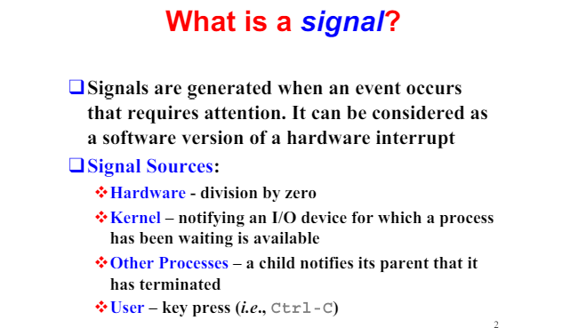
SIGNALS

Slide 3
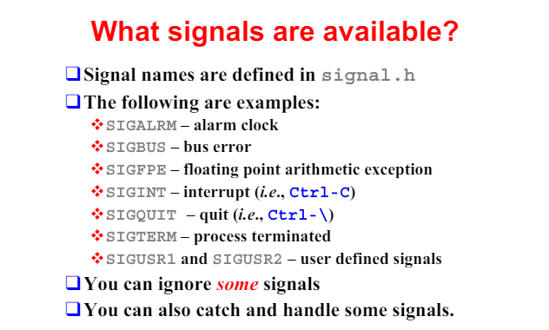

Slide 4
SIGNAL HANDLING
Signal handling is a crucial aspect of Unix-like operating systems, allowing processes to respond to various events or interrupts, known as signals. Signals are asynchronous notifications sent to a process to indicate events such as errors, hardware exceptions, or user-defined events.
Here's a more detailed explanation of signal handling:
Signal Types: Signals can represent various types of events, including:
Standard Signals: Predefined signals such as SIGINT (interrupt from keyboard), SIGSEGV (segmentation fault), SIGTERM (termination request), etc.
Real-Time Signals: Signals that provide more precise timing information and are typically used in real-time systems.
User-Defined Signals: Custom signals that can be defined and sent between processes for inter-process communication.
Signal Delivery: Signals can be delivered to a process in several ways:
Asynchronous: Signals can arrive at any time, interrupting the normal flow of execution.
Synchronous: Signals generated as a result of specific actions, such as dividing by zero or accessing invalid memory locations.
Signal Handlers: Signal handling involves defining functions, known as signal handlers, to handle specific signals. Signal handlers are functions that are executed when a signal is received by a process. They allow the process to respond to signals in a controlled manner.

Slide 5
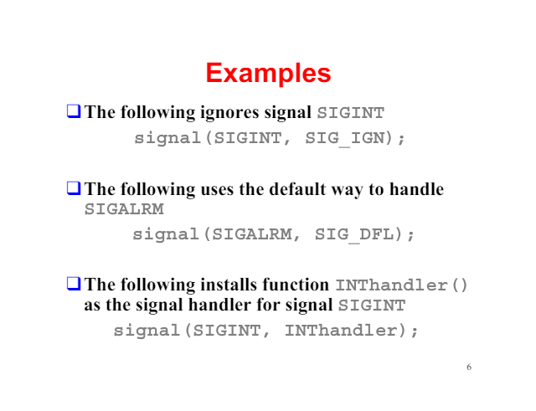

Slide 6
4. Registering Signal Handlers: In C programming, signal handlers are registered using the signal() or sigaction() function. These functions associate a signal with a handler function.
5. Default Actions: Each signal has a default action associated with it, such as terminating the process, ignoring the signal, or generating a core dump. Signal handlers can override these default actions to implement custom behavior.
6. Signal Masking: Signal masking allows processes to block certain signals temporarily to prevent them from being delivered during critical sections of code execution. This can prevent interruptions that might lead to unpredictable behavior.
7. Signal Interruption: Signals can interrupt the normal execution flow of a program, causing it to jump to the corresponding signal handler. Once the signal handler completes execution, the program resumes execution from where it was interrupted.
8. Signal Safety: Signal handlers should be designed to be signal-safe, meaning they should only execute code that is guaranteed to be reentrant and not interfere with other signal handlers or critical sections of code.
9. Signal Numbers: Signals are identified by unique integer numbers. For example, SIGINT is usually represented by the number 2, SIGSEGV by 11, SIGTERM by 15, etc. Standard signals are defined in the <signal.h> header file.
10. Signal Delivery Mechanism: When a signal is generated, the operating system interrupts the normal flow of execution of the process and delivers the signal to it. The process can handle the signal by executing a predefined signal handler function.

Slide 7
THREE ENCOUNTERED SIGNALS
SIGINT (Signal Interrupt):
Number: 2
Description: SIGINT is generated when a user sends the interrupt signal typically by pressing Ctrl+C. It's commonly used to request the termination of a process from the terminal.
Default Action: Termination of the process. By default, this signal causes the process to terminate gracefully, allowing it to clean up resources before exiting.
Common Use: SIGINT is often used to gracefully terminate command-line programs or interactive processes running in a terminal. For example, when you press Ctrl+C to stop a running program.
Real-Life Use: SIGINT is commonly used in interactive command-line programs and terminal sessions. When a user wants to stop a running process, such as a long-running computation or a program execution, they can press Ctrl+C to send a SIGINT signal to the process. This allows the process to gracefully terminate and clean up resources.
Implementation: In C programming, the signal() function or the sigaction() function is used to register a signal handler for SIGINT. When the process receives a SIGINT signal, the signal handler function is invoked, allowing the process to perform cleanup operations before exiting.

Slide 8
THREE ENCOUNTERED SIGNALS
SIGSEGV (Signal Segmentation Violation):
Number: 11
Description: SIGSEGV is generated when a process attempts to access a memory location that is not allowed, typically due to a segmentation fault or invalid memory access.
Default Action: Termination of the process. By default, this signal causes the process to terminate immediately without any cleanup.
Common Use: SIGSEGV indicates a serious programming error, such as accessing a NULL pointer or accessing memory that has not been allocated. It's often used for debugging and identifying memory-related issues in programs.
Real-Life Use: SIGSEGV indicates a serious error in a program, such as accessing invalid memory locations or dereferencing a NULL pointer. When a program encounters a segmentation fault, it typically terminates immediately, and the operating system generates a SIGSEGV signal. This helps identify and diagnose memory-related bugs and issues in programs.
Implementation: SIGSEGV is handled by the operating system's kernel when it detects an illegal memory access by a process. Typically, the default action for SIGSEGV is to terminate the process immediately without any cleanup. However, programs can install custom signal handlers to catch SIGSEGV and perform error handling or logging before exiting.

Slide 9
THREE ENCOUNTERED SIGNALS
SIGTERM (Signal Termination):
Number: 15
Description: SIGTERM is a general-purpose signal used to request the termination of a process. It's typically sent by the kill command or by other processes to gracefully terminate a process.
Default Action: Termination of the process. By default, this signal causes the process to terminate gracefully, allowing it to clean up resources before exiting.
Common Use: SIGTERM is commonly used to request the termination of a process in a controlled manner. Unlike SIGKILL, which terminates the process immediately, SIGTERM allows the process to perform cleanup operations before exiting. It's often used in shutdown scripts or process management.
Real-Life Use: SIGTERM is used to request the graceful termination of a process. It is commonly sent by system administrators or process management tools to shut down or stop a running process in a controlled manner. Unlike SIGKILL, which terminates the process immediately, SIGTERM allows the process to perform cleanup operations before exiting.
Implementation: Similar to SIGINT, SIGTERM can be handled by registering a signal handler using the signal() function or the sigaction() function. When a process receives a SIGTERM signal, the signal handler is invoked, allowing the process to perform cleanup operations and exit gracefully. Alternatively, processes can choose to rely on the default action of SIGTERM, which is to terminate the process gracefully.

Slide 10
SIGALRM (Signal Alarm):
Real-Life Use:
In network programming, SIGALRM can be used to implement timeouts for various operations, such as waiting for client responses or performing network transactions.
In real-time systems, SIGALRM is often employed to schedule periodic tasks, such as updating sensor data or performing system maintenance.
Implementation:
Applications can set an alarm using the alarm() function, which takes the number of seconds until the alarm should trigger as its argument.
Once the specified time elapses, the process receives the SIGALRM signal, interrupting its normal execution flow and allowing it to handle the timing event accordingly.
SIGUSR1 and SIGUSR2 (User-defined Signals):
Real-Life Use:
In multi-process applications, SIGUSR1 and SIGUSR2 can be used for inter-process communication, signaling specific events or conditions between processes.
Applications may define their own conventions for using these signals, such as indicating the need for a process to reload its configuration or perform a specific action.
Implementation:
Developers can register signal handlers for SIGUSR1 and SIGUSR2 using the signal() or sigaction() functions, specifying custom handler functions to execute when these signals are received.
Upon receiving SIGUSR1 or SIGUSR2, the process can execute the corresponding signal handler, enabling it to respond to the signaled event or condition as desired.

Slide 11
SIGKILL (Signal Kill):
Real-Life Use:
SIGKILL is often employed as a last resort for terminating processes that are unresponsive, stuck in an infinite loop, or posing a threat to system stability.
System administrators may use SIGKILL to forcibly terminate processes that cannot be terminated through normal means, such as when they are consuming excessive resources or exhibiting abnormal behavior.
Implementation:
SIGKILL is invoked using system utilities like the kill command or programmatically through system calls such as kill() with the SIGKILL signal.
Upon receiving SIGKILL, the operating system immediately terminates the targeted process without allowing it to perform any further actions or cleanup. This ensures the swift termination of the process, albeit without any opportunity for graceful shutdown or resource cleanup.

Slide 12
Handling Signals in Multithreaded Programs
Introduction
Signals are asynchronous events that can interrupt program execution.
Multithreaded programs have multiple threads, each with its own flow of execution.
Signal Handlers
Signal handlers are special functions that are executed in response to signals.
In multithreaded programs, each thread can have its own set of signal handlers.
Thread Safety
Signal handlers must be thread-safe to avoid race conditions or deadlocks.
Avoid non-reentrant functions and shared resources in signal handlers.
Signal Delivery
By default, signals can be delivered to any thread in the program.
Use pthread_kill() to send a signal to a specific thread.
Blocking Signals
Threads can block signals temporarily using pthread_sigmask() to prevent them from being delivered.
Be cautious when blocking signals to avoid missing important signals.

Slide 13
Signal Mask
Each thread has its own signal mask, which determines which signals are currently blocked.
Manipulate the signal mask using sigprocmask() to control signal delivery.
Signal Synchronization
Signals can be used for inter-thread communication and synchronization.
Use signals judiciously to avoid race conditions and ensure proper synchronization.
Signal Safety
Be aware of signal-safe functions that can be safely called from within a signal handler.
Avoid calling non-reentrant or thread-unsafe functions in signal handlers.
Debugging
Use debugging tools like GDB to analyze signal handling and thread behavior.
Pay attention to signal handlers and their impact on the program's execution flow.

Slide 14
GDB COMPILER
Simple C program that calculates the sum of the first n natural numbers:
#include <stdio.h> int sum_of_natural_numbers(int n) { int sum = 0; for (int i = 1; i <= n; ++i) { sum += i; } return sum; } int main() { int n = 10; int result = sum_of_natural_numbers(n); printf("Sum of the first %d natural numbers is %d\n", n, result); return 0; }
To debug this program using GDB, you can follow similar steps as before:
Compile the program with debugging symbols enabled:
gcc -g -o sum sum.c

Slide 15
Start GDB with the compiled program:
gdb sum
Set breakpoints at specific locations in the code, such as at the sum_of_natural_numbers function or at the printf statement in the main function:
(gdb) break sum_of_natural_numbers (gdb) break main
Run the program within GDB:
(gdb) run
Use GDB commands to navigate through the code, inspect variables, and analyze program behavior. For example:
(gdb) step (gdb) print n (gdb) continue
When you're finished debugging, exit GDB using the quit command:
(gdb) quit

Slide 16
Thank you

